Slide 1
Heart Disease Machine Learning Model
By: Abdelhamead Ibrahim

Slide 2
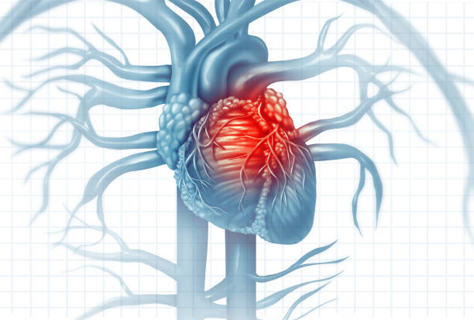

Slide 3
Cardiovascular Heart Diseases
Cardiovascular diseases (CVDs) are the number one cause of death globally, taking an estimated 17.9 million lives each year, which accounts for 31% of all deaths worldwide.
Four out of five CVD deaths are due to heart attacks and strokes, and one-third of these deaths occur prematurely in people under 70 years of age.
People with cardiovascular disease or who are at high cardiovascular risk (due to the presence of one or more risk factors such as hypertension, diabetes, hyperlipidaemia or already established disease) need early detection and management wherein a machine learning model can be of great help.

Slide 4
Our Data
Our Machine Learning model will use the following information to predict if a Patient has Heart Disease :
Age
Sex
ChestPainType
RestingBP
Cholesterol
FastingBS
RestingECG
MaxHR
ExerciseAngina
Oldpeak
ST_Slope
HeartDisease

Slide 5
Insights
The Dataset showed a higher occurrence of Heart Disease in women in specific age ranges.
In the Line Plot below we can see that women in their 40s were more likely to have heart disease than their male counterparts.
In the Age Range of 70 Women had a higher occurrence of Heart Disease in comparison to their male counterparts. This is unexpected because Heart Disease traditionally occurs in males at a higher rate in comparison to females.

Slide 6
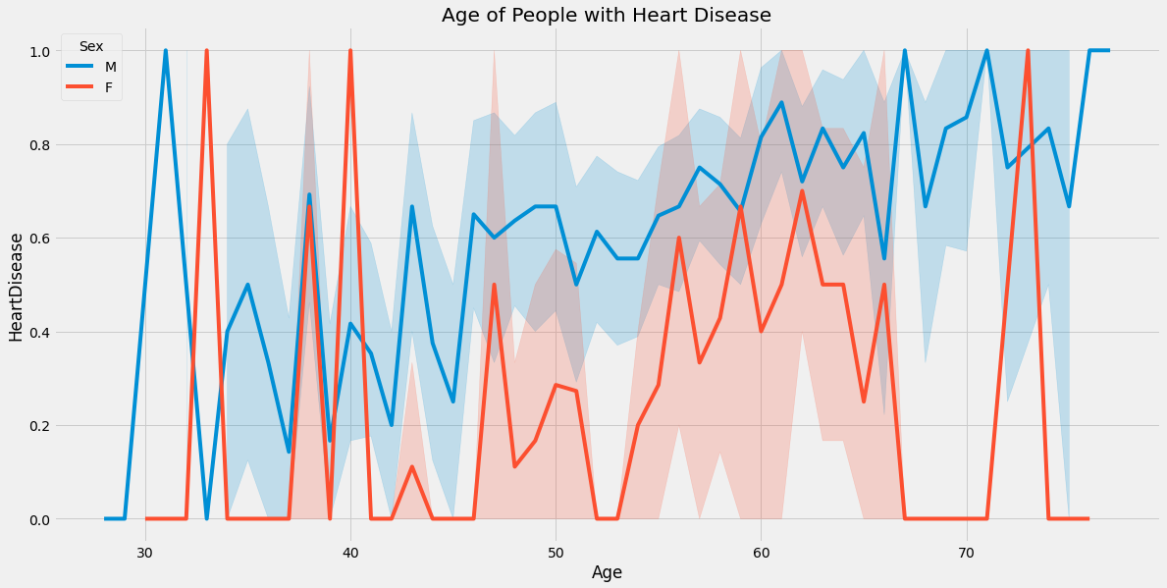

Slide 7
Limitations of the Data
The Limitation of my dataset is that the data was gathered from patients in Hungary. We can use data from other countries just in case there is a higher or lower occurrence of Heart Disease in Hungary compared to other countries.
Another Limitation is there was a higher number of Males Compared to Females in the Dataset.

Slide 8
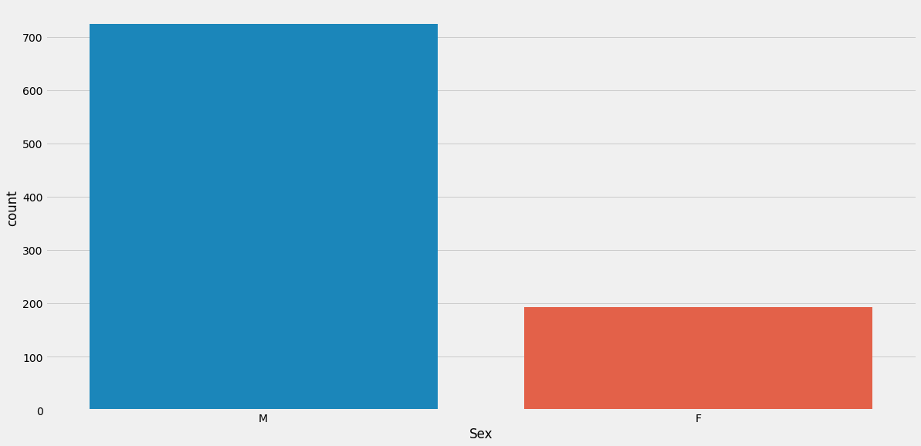

Slide 9
Next Steps
The Machine Learning Model was able to predict the occurrence of Heart Disease in the patients this model was accurate and helped prevent False Negative predictions.
A False Negative would have a detrimental effect on a patient’s health outcomes, because Heart Disease would remain unnoticed and the patient would not be treated for the condition

Slide 10
Recommendation
My Recommendation for the Stakeholders is to use my model to predict Heart Disease in their patients.

